Slide 1
CS 115 Lecture
Structured Programming
Taken from notes by Dr. Neil Moore

Slide 2
The bad old days: GOTO
In the early days of programming, we didn’t have for loops, if statements, etc.
Instead, we had just “if this is true, go to 10”.
You could use that to skip over code (like an if does)
… or go back to an earlier line to make a loop
This was very tedious and error prone
  Especially if something had to be changed
  “Spaghetti code”: trying to trace a program’s execution was like trying to trace one strand of spaghetti in a plate of it

Slide 3
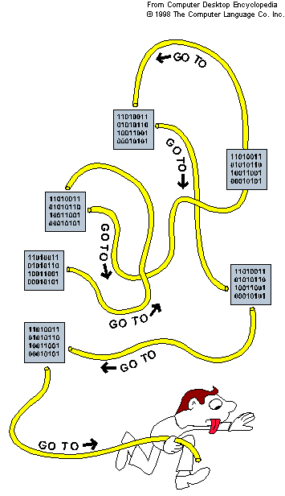
Spaghetti code

Slide 4
Structured programming
In the 1960’s, computer scientists started to think about how to write programs that were easier to understand and modify.
  Edsger Dijkstra, “Go To Statement Considered Harmful” (1968)
They introduced the paradigm of structured programming.
  Patterns that lead to easier-to-understand code
    Easier to test and debug
    Easier to modify and maintain
    Easier to collaborate on large programs

Slide 5
Data structures and Control structures
We’ve already seen a little about data structures
  The ways of organizing data in a program
  Simple ones: constants and variables
  More complex: graphics objects, strings, lists, …
Control structures are ways of controlling the execution of a program
  which statements execute, and in which order

Slide 6
The three basic control structures
In 1966, Böhm and Jacopini showed that any program using “go to” could be rearranged to use only three simple control structures
  Sequence
  Selection
  Iteration
  Added a fourth later: Subprograms (more in chapter 5)
Each of these control structures has two important guarantees:
Only one way to enter the control structure
Only one way to exit the control structure
One entrance, one exit.

Slide 7
The sequence control structure
“Sequencing” or “sequential execution” just means:
running one statement after another
In Python we write one line after the next
“The default” control structure
Guarantees unique to sequence
  The steps will execute in the order given
  Steps will not be skipped
  It will always start at the first statement …
  And finish at the last statement of the sequence

Slide 8
Selection control structure
“Selection” means choosing which code to run based on a condition or question
In Python, an if-else statement
Two branches, based on True and False
  Each branch is another control structure (most often a sequence, can be a loop or another if)
Guarantees:
  Always starts with the question/condition
  Runs one branch or the other, never both
  … and never neither – MUST do one of the two
Avoid dead code: code that is never executed – not just not executed on one particular run, but NEVER executed
  Usually because the condition is always False

Slide 9
Iteration control structure
“Iteration” means running code multiple times (a loop)
In structured programming, “repeat this body until a condition is false”
In Python, a while loop (in about a week)
  for loops are a special case of iteration
Guarantees:
  Always starts with the question/condition
  If the condition is True, executes the entire body, then comes back to the condition
  If the condition is False, leaves the loop
Beware of infinite loops where the condition is always True

Slide 10
Subprogram control structure
Sometimes we need to repeat the same code in several different places
  It would be nice if we didn’t have to write the code multiple times
  A subprogram is a chunk of the code treated as a single unit
  When we need to execute that code, we call (invoke) the subprogram
    The call runs the subprogram, waits for it to finish
    Then execution keeps going from where the call is
    Sometimes we send values to the subprogram
    Sometimes the subprogram sends value(s) back

Slide 11
Subprogram control structure
In Python, subprograms are called functions
  Arguments are the values we send to the function
  And the function can return a result (or results)
  Can you think of Python functions that
    Take one or more arguments?
    Take no arguments?
    Return a result?
    Don’t return a result?

Slide 12
Subprogram control structure
Guarantees for subprograms:
  Forces the invoking code to pause execution
  Starts execution at top of subprogram code
  Completes execution at bottom of subprogram
  Always returns execution control to the point where the subprogram was invoked
  Does NOT execute unless invoked (called)

Slide 13
Control structures summary
Sequence (one statement after another, easy to forget its name!)
Selection (conditionals: if and variations)
Iteration (loops: for and while)
Subprogram (functions: def and calls)

